Slide 1
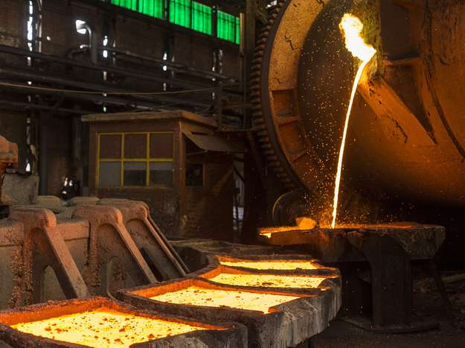
higher Design & Manufacture
Metal Processes

Slide 2
Learning intentions & success criteria
Learning Intentions
Introduction and overview of the metal processes.
Success Criteria
Describe and explain different metal manufacturing processes.
Determine which process certain metal products were produced with.
Determine which process is most suitable for your design.

Slide 3
Metal Processes
Reforming Processes
Metal Extrusion
Gravity Die Casting
High Pressure Die Casting
Sand Casting
Deforming Processes
Piercing/blanking/ press forming
Drop forging
Hot rolling/cold rolling
Spinning
Machining Processes
Milling
Metal Lathe

Slide 4
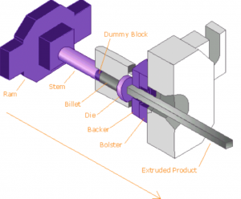
Metal Extrusion
Molten metal is pushed through a shaped hole
As it passes through the hole, it cools and solidifies
Components which have a long, continuous profile
Tubes, rods, shaped bars
Aluminum window frames
Structural frames for cars or aircraft
Types of metal
Dies are usually made from steel, therefore metals used must have lower melting point
Copper is common in water pipes

Slide 5
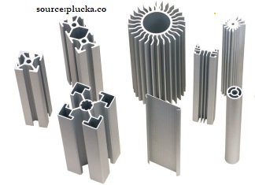
Metal Extrusion
Advantages
Cross section can be extremely complex
Hollow items can be made
Different wall thicknesses
Reinforcing webs can be used to save material
No marks left like mould lines
Dimensions can be accurately controlled
Disadvantages
Molten steel would damage a steel die therefore not possible to make components from steel
Limitations to overall length depending on how much steel is used in the cross section and the chamber capacity

Slide 6
Metal Extrusion
The Process (2 methods)
Method 1
Direction Extrusion (forward extrusion)
Uses a ram to push molten metal through a hole in a die
Once the metal takes the shape of the mould, it cools and solidifies
Method 2
Indirect Extrusion
The ram used in backward extrusion is a hollow tube, which also has the die attached
As the ram moves forward, the molten metal in the chamber is forces through the hole in the die.
Video: https://www.youtube.com/watch?v=Y75IQksBb0M

Slide 7
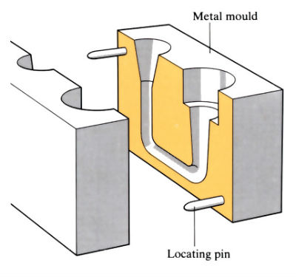
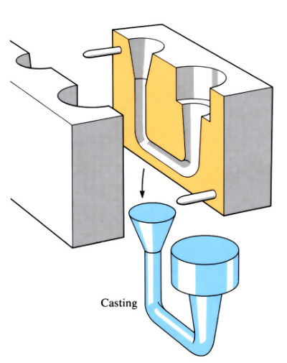
Gravity Die Casting
Process to make solid shapes with a melting point lower than steel
Uses a steel or cast iron two part die
Molten metal is poured in and allowed to cool
Secondary drilling or machining can then be done to complete the part
Products include: car alloy wheels, machinery feet, weights, brackets etc.
Metals used include: aluminium alloys, brass, lead, zinc, magnesium.

Slide 8
Gravity Die Casting
Advantages:
Medium to high volume production
Can be partially automated
Reasonably good level of surface detail and finish
Internal stresses kept to a minimum
Internal tears less likely
Disadvantages
Excess metal left in the feeder system must be cut off and files before components are completed
Slow process compared to others
Thin-walled forms are difficult to achieve

Slide 9
Gravity Die Casting
The Process
Stage A
A mould is made in two parts
They close to form a mould cavity
Stage B
Surface of the mould cavity is treated with powder to help the metal flow
Mould halves are clamped together
Stage C
Metal is heated and poured into the feeder system to fill the cavity
Mould is tapped or shaken to aid the flow and release gas
Stage D
Metal cools and solidifies
Feeder system is removed
Excess metal is trimmed and filed
The mould is removed
Video: https://www.youtube.com/watch?v=xxPLYjqOx9k

Slide 10
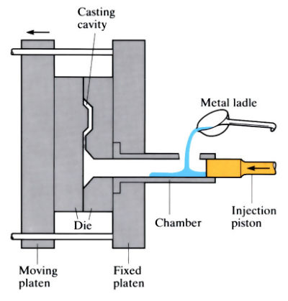
High Pressure Die Casting
Uses a two part steel die
Molten metal is injected under high pressure
It is rapidly cooled
Products can be more intricate than gravity die casting
Metals used: aluminium alloys, brass, zinc, magnesium alloys

Slide 11
High Pressure Die Casting
Advantages
High volume production
Automated process
High level of detail
Good surface finish
Complex shapes
Metal cools quickly
Low cycle time
Disadvantages
Excess metal requires trimming
Cost of steel moulds is high
Internal stresses created by high pressure can be great

Slide 12
High Pressure Die Casting
The Process
Stage A
A hydraulic system closes and seals the two die halves
Stage B
Molten metal is poured from a ladle into the open injection system
Stage C
A ram slowly pushes the molten metal along until it reaches the cavity, slowly to allow gases to escape
Stage D
The ram rapidly pushes the metal into the mould, filling the cavity
Cold water is flushed through channels in the mould which cools the metal
Stage E
The hydraulic system opens the mould
The ram returns to its starting position
Stage F
Ejector pins push the component out of the mould
Video: https://www.youtube.com/watch?v=sdO1y0ngDmY

Slide 13
Sand Casting
Process used to manufacture metal components with complex shapes
Uses sand as a mould into which molten metal is poured and allowed to cool and solidify
Components with holes can be produced
The more complex the shape, the more complex the pattern (solid block which sand is formed around, usually made of wood)

Slide 14
Sand Casting
Iron is the most common metal
Other include: brass, bronze, aluminium etc.
Advantages:
Complexity of shape of finished component
Low cost method of production
Cost of pattern making is low
Used with high melting point metals
Suitable for small scale production
Disadvantages
Very labour-intensive (sand mould has to be remade each time)
Further machining of component is often necessary
Video: https://www.youtube.com/watch?v=szOwGvYO_Tc

Slide 15
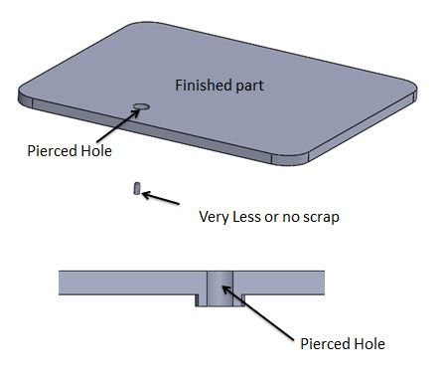
Piercing/Blanking/Press Forming
Piercing is process in which a punch operation cuts a hole by tearing material from a final piece of sheet metal.

Slide 16
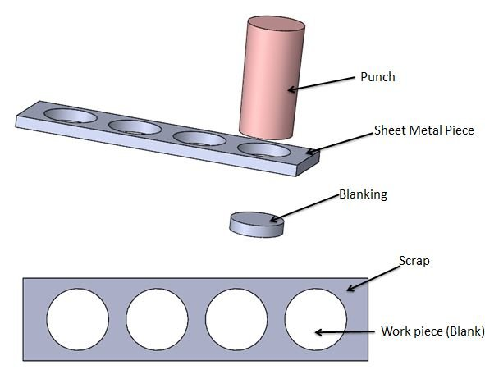
Piercing/Blanking/Press Forming
Blanking is a process in which the punch operation removes a final product from a larger piece of sheet metal.

Slide 17
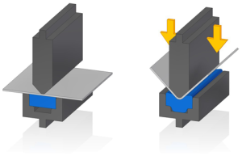
Piercing/Blanking/Press Forming
Press Forming
Uses a former to fold sheet metal into shape

Slide 18
Piercing/Blanking/Press Forming
Types of metal used on all three processes:
Must be ductile
Mild steel, stainless steel, aluminium, copper etc.
Advantages:
Highly automated
Continuous feeds of material fed into the machine
Accurate and repeatable
Scrap can be recycled easily
Disadvantages
Leaves distinctive marks on the edge of components
Work hardening can also happen at the edges

Slide 19
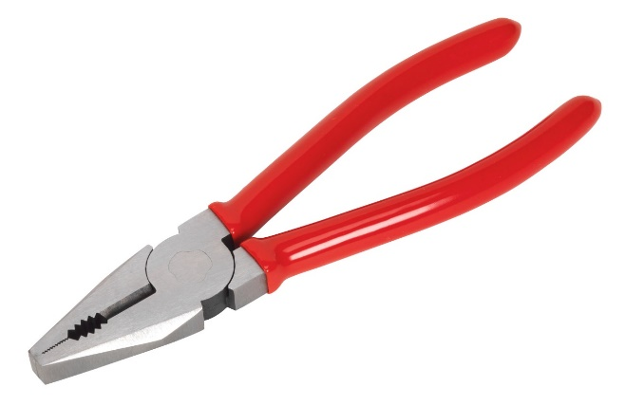
Drop Forging
Uses a powered hammer which hits a heated solid metal blank
This forces it into the shape of the metal die
Used for:
Items that require a degree of hardness
Examples: spanners, pliers, screwdrivers, chain links etc
Metals used:
Titanium, aluminium alloys, stainless steel

Slide 20
Drop Forging
Advantages:
Hardening and strengthening of components
Used on a wide range of components from small jewellery to large truck axles
Precision drop forging made close to the finished article requires minimum removal of waste
Disadvantages
Limitations to the shape
Flash will need to be removed (waste material)
Difficult to do further machining to drop-forged metal components
Video: https://www.youtube.com/watch?v=VPbJSLE0zic

Slide 21
Hot Rolling/Cold Rolling
Rolling is the process of deforming metal by squeezing it between a set of rollers
Creates forms like bars or sheets
HOT Rolling:
Steel billets are heated to soften the steel, making it easier to change shape
Can be used to make, for example: steel beams
COLD Rolling
Can be performed on sheet materials which do not need to soften. Carried out at room temperature
Can be used to make, for example: corrugated roofing
Video: https://www.youtube.com/watch?v=KRn73gKQ2YU

Slide 22
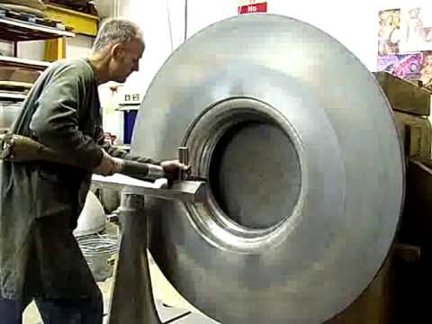
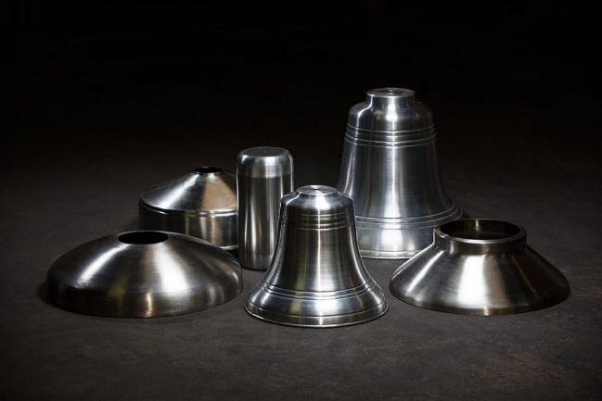
Spinning
Process by which a disc or tube of metal is rotated at high speed.
This is formed into an axially symmetrical part.
Can be done by hand or by lathe.
Unlike wood turning on a lathe, metal spinning does NOT involve the removal of metal.
It concerns the shaping of a metal sheet over an existing shape.
Complex shapes can be spun.

Slide 23
Spinning
Process:
A formed block is mounted on the drive section
Pre-sized metal disc is then clamped against the block
They are both rotated together at high speeds
Force is then applied to the metal using tools
This forces the metal sheet over the block to eventually take the same shape
Video: https://www.bing.com/videos/search?q=metal+spinning&adlt=strict&view=detail&mid=681F361D595D8E85DBB5681F361D595D8E85DBB5&&FORM=VRDGAR

Slide 24
Milling
Machining process which uses rotary cutters to remove material
Cutter can move in several directions as well as at an angle
Can be used for a wide range of part sizes
Cutting occurs on the circumference of the cutter rather than a normal drill’s rotational axis
Video: https://www.youtube.com/watch?v=gbjzfE4JA3g

Slide 25
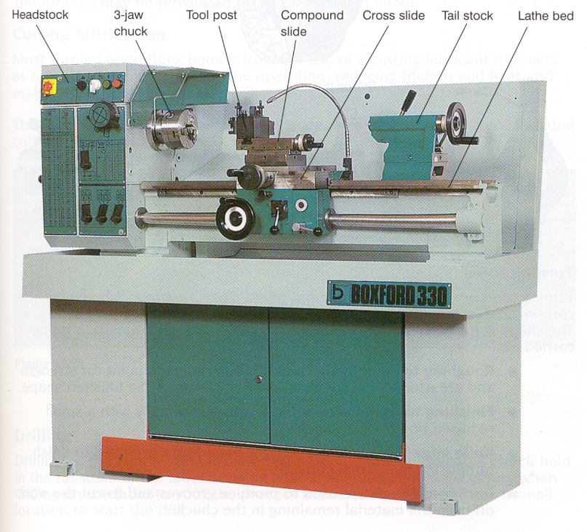
Metal Lathe
Used to make cylindrical components from metals
The metal is held firmly and is rotated whilst a single-point cutting tool cuts the work using a wedge-cutting action
The shape of the work depends on the path taken by the tool
Video: https://www.youtube.com/watch?v=tRCirIcamVU

Slide 26
Past Paper question

Slide 27
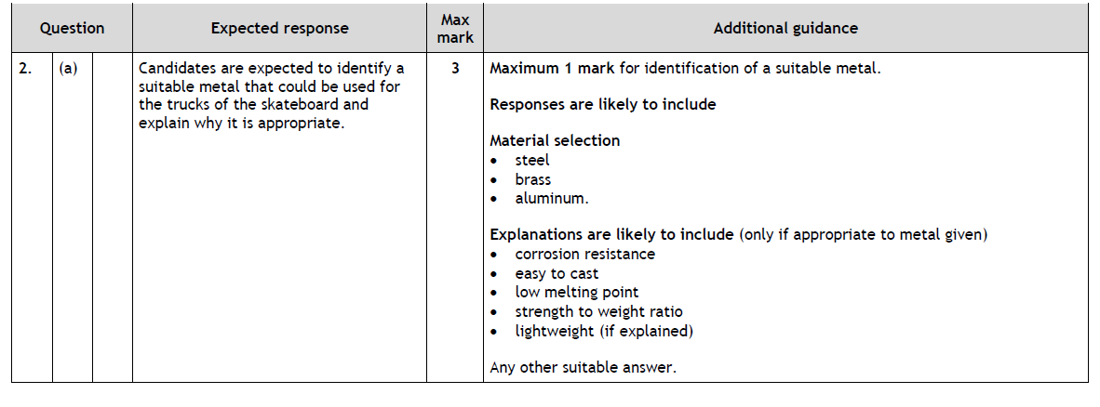
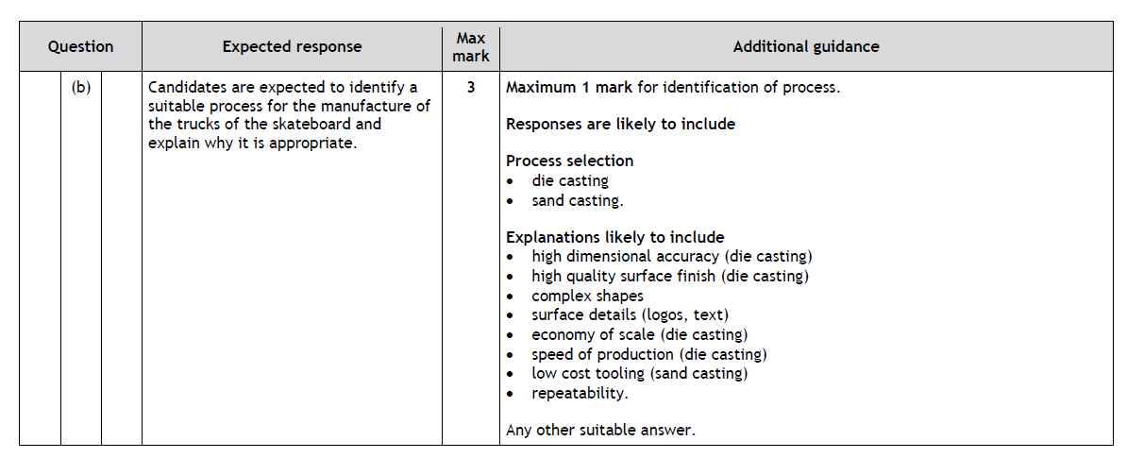
Past Paper Answers

